Slide 1

Layout of LS3MIP
Bart van den Hurk (hurkvd@knmi.nl)
Gerhard Krinner (krinner@ujf-grenoble.fr)
Sonia Seneviratne (sonia.seneviratne@ethz.ch)
Chris Derksen (Chris.Derksen@ec.gc.ca)
Taikan Oki (taikan@iis.u-tokyo.ac.jp)
Hyungjun Kim (hjkim@rainbow.iis.u-tokyo.ac.jp)

Slide 2
Agenda
3 Keynotes by LS3MIP team
  general intro (Bart vd Hurk)
  forcing data offline runs (Hyunjun Kim)
  planned analyses (Gerhard Krinner & Sonia Seneviratne)
Inventory of plans and issues by participants
Issues to be resolved

Slide 3
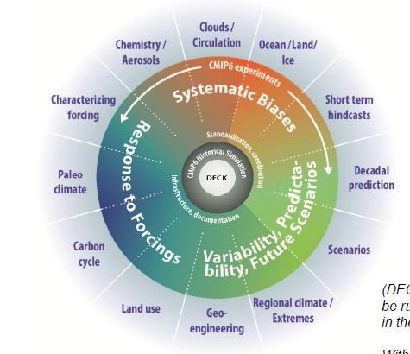
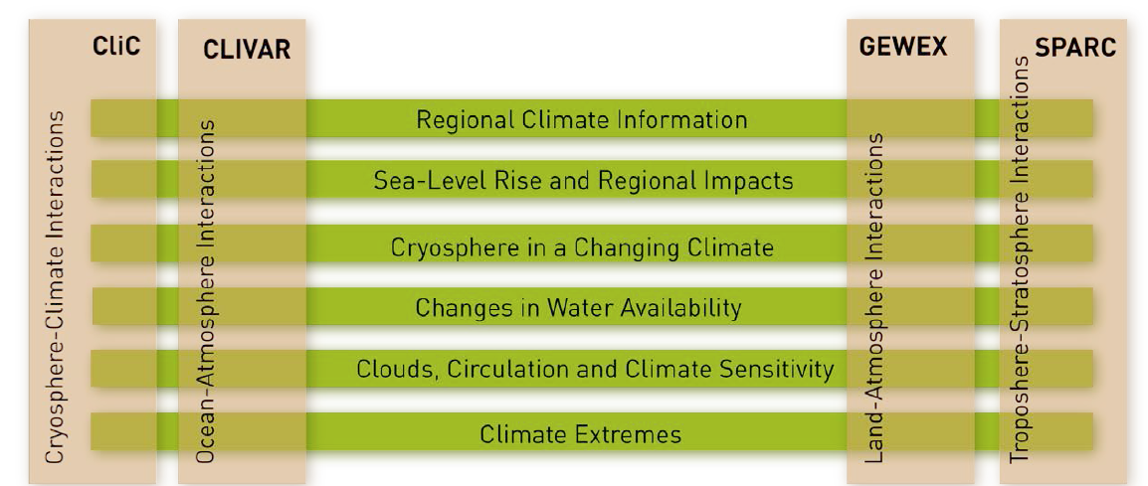
Overview and scientific goal
Multi-model based reanalysis of land surface (from early 20th century)
Explore land-atmosphere coupling and its impacts (for climate trends, water resources, predictability)
Link patterns and trends of ECVs to model properties and biases

Slide 4
Tier 1 experiments
Coupled model simulations with 30yr running mean soil moisture/snow conditions
Coupled model simulations with prescribed 1980-2014 soil moisture/snow conditions
Offline land model simulation over 20th century

Slide 5
Tier 2 experiments
Potential predictability experiments
Offline land model simulation over 21th century
AMIP-type simulations

Slide 6
The LMIP goals
Routine multi-model reanalysis
  Trend/variability on water resources & general hydrological quantities
Analysis toolkit
  Detections and attributions of climate change impacts on the trends
  Of course, one of the expected challenges is the quantification of feedbacks from human activities, such as irrigation, to the future climate predictions by AOGCMs.
Scenario engine
  Future assessments based on full combinations of RCPs and SSPs, including anthropogenic interventions on water cycles

Slide 7
FAQ items
An LS3MIP FAQ is kept here:
  https://docs.google.com/document/d/1SHhepbym5mKJeXb6qi-HcExbndceGnbyxYLP-JrZfgc/edit
Main topics
  general info (background docs, mailing list)
  time line information
  storage of data from experiments: variables, formats & resolution, repositories)
  bias correction of offline runs
  coordinated analyses (see also presentation Gerhard/Sonia)

Slide 8
Extra slides

Slide 9
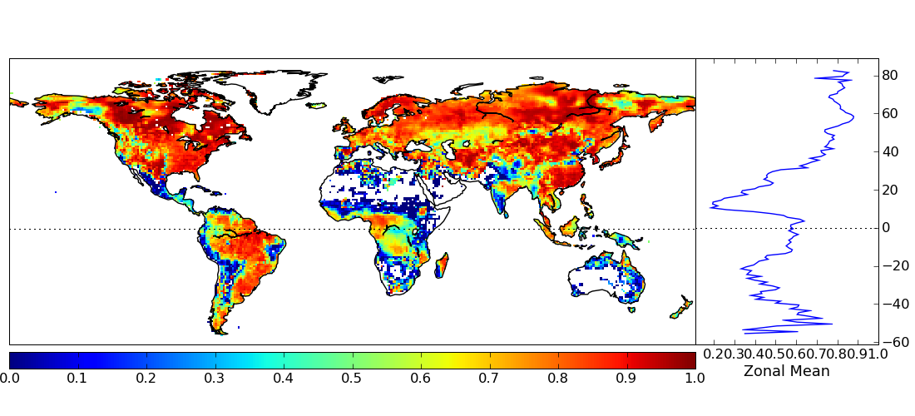
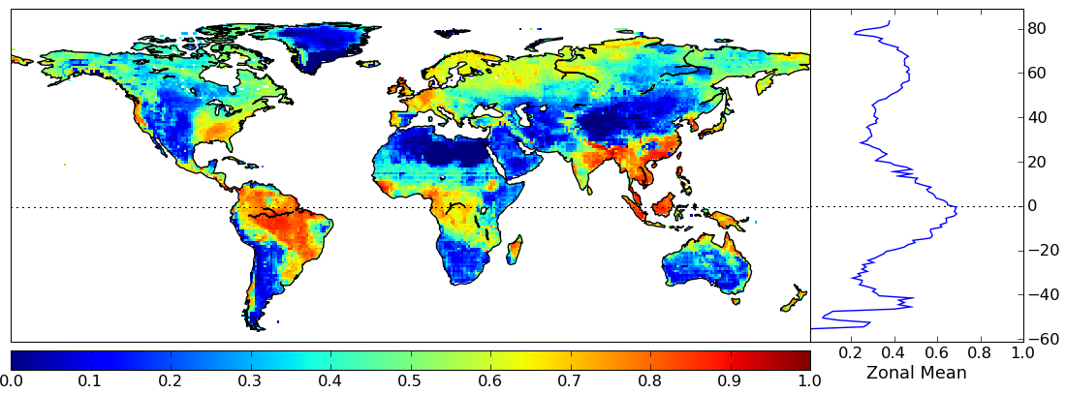
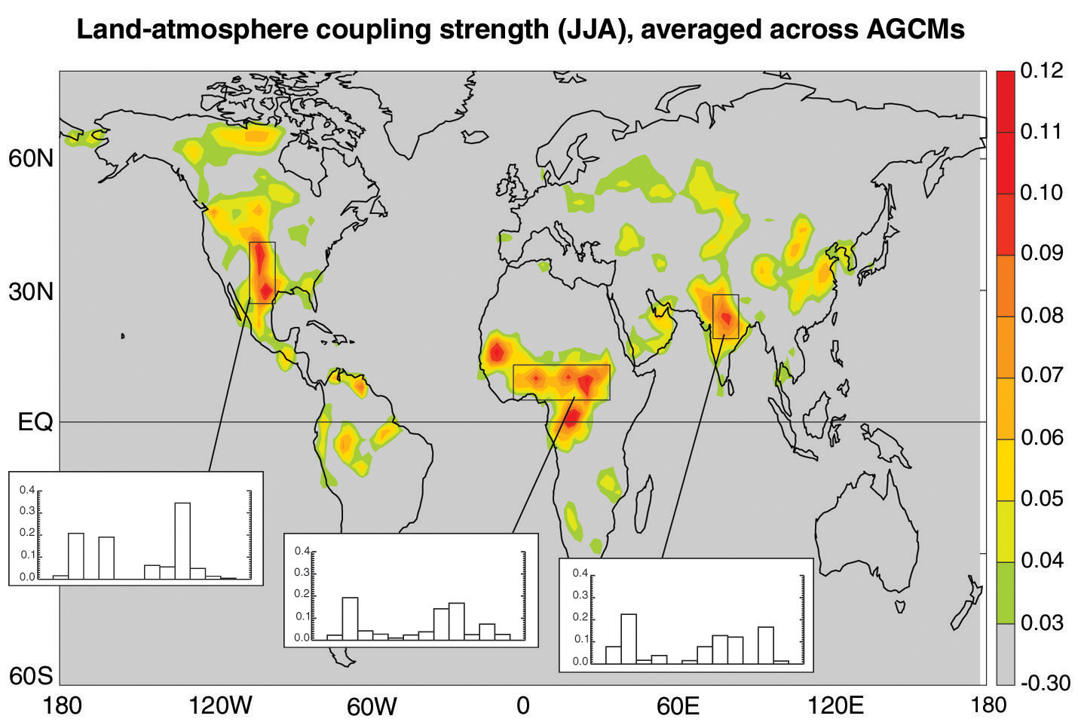
Gap filled by LS3MIP (1)
Map (uncertainty of) water resources over the 20th century (and beyond)
Explore model-dependent land-atmospheric coupling
Kim et al (2015) showing that disparity in GSWP2 runoff from uncertainty in precipitation is much less than model uncertainty
Ω_{Pr}=0.66
Ω_{Mo}=0.41
Koster et al (2006): GLACE result showing model-specific land-atmospheric coupling strength

Slide 10
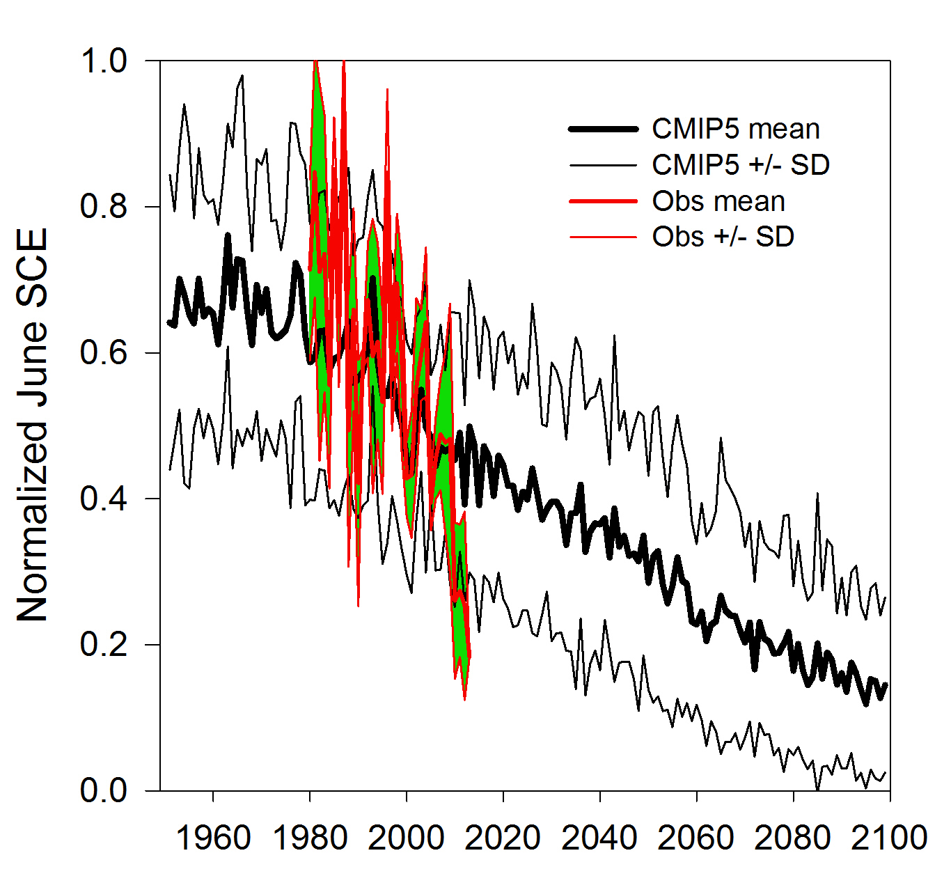
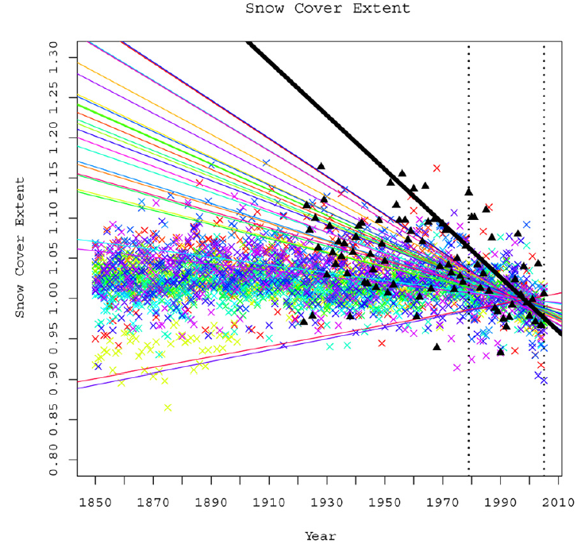
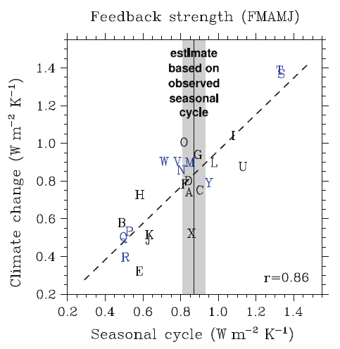
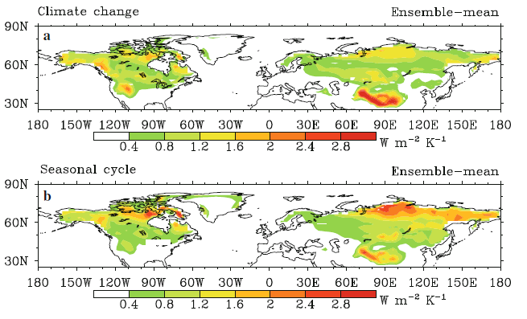
Gap filled by LS3MIP (2)
Ability of climate models to capture observed rates of spring snow cover reductions
Linkage between snow-albedo feedback and 21st century warming
Brutel-Vuilmet et al. (2012); Derksen and Brown (2012): CMIP5 models underestimate the significant reductions in spring snow cover extent observed during the satellite era
Qu and Hall (2013): The spread in snow albedo feedback accounts for much of the CMIP5 spread in the 21st century warming of Northern Hemisphere land masses

Slide 11
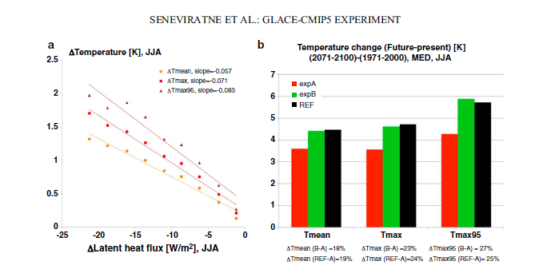
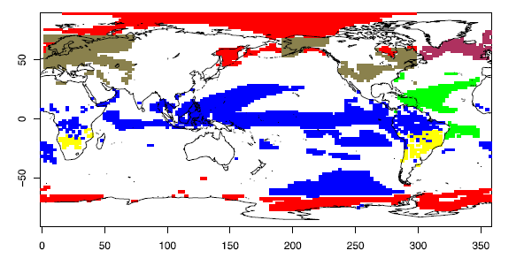
Gap filled by LS3MIP (3)
Soil moisture affecting the climate change signal
(Seasonal) Predictability can alter in a warmer climate
Seneviratne et al (2014): GLACE-CMIP5 result showing effect of prescribing 20th century soil moisture climatology
Del Sole et al (2014): Changes in seasonal predictability as a result of a trade-off between more signal and more noise in a warmer world

Slide 12
Connection to DECK and other MIPs
Offline land-only (LMIP):
  Also baseline for C4MIP and LUMIP
Historical runs (1900-2014) serve as reference runs
Future simulation to be selected from Scenario-MIP portfolio

Slide 13
Participants
ACCESS
BCC-CSM2-MR
CanESM
CESM
CMCC
CNRM-CM
EC-Earth
FGOALS
GFDL
GISS
IPSL-CM6
MIROC6-CGCM
MPI-ESM
MRI-ESM1.x
NorESM
UKESM

